Slide 1

By: Jet Developers

Slide 2
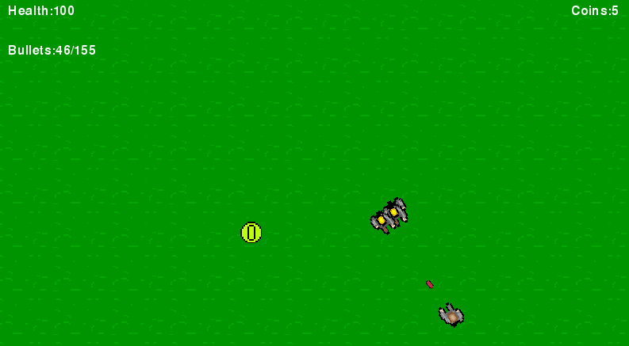

Slide 3
